Slide 1
Django Blog
Banda Rakesh
20048

Slide 2
Abstract
A Django-powered blogging platform connecting users within the same school domain. Users can register using a valid school email, create posts, like, and comment, fostering a localized community experience. The project emphasizes domain-specific access control and user-generated content.
“I have neither given nor received unauthorized aid in completing this work, nor have I presented someone else’s work as my own”

Slide 3
Project Overview
Technologies & Architecture
A secure blogging platform built with Django:
Features: Registration, Post Creation, Like, and Comment.
Access limited to users within the same school domain.
Promotes community engagement among students and alumni.
Core Technologies:
Backend: Django with Python.
Frontend: HTML, CSS, and Django Templates.
Database: SQLite for development, scalable to other DBs.
Key Features:
Modular structure for scalability.
Secure user authentication and validation.
Efficient database queries for school-based content filtering

Slide 4
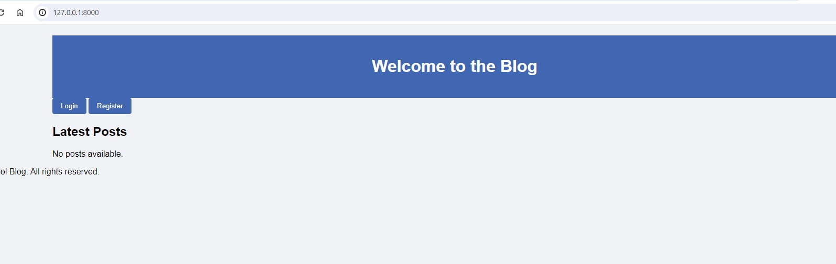

Slide 5
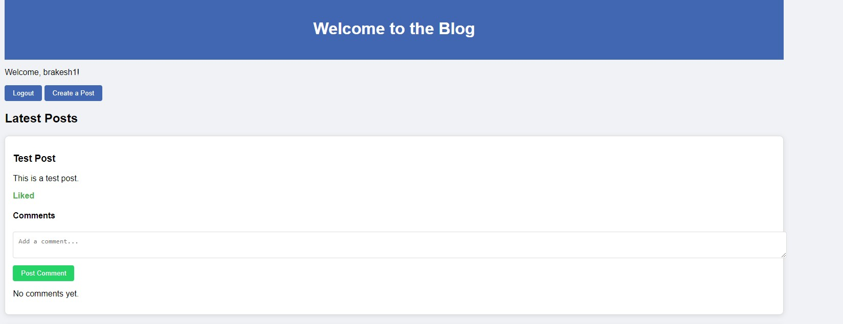
Home page of the user who registered through sfbu.edu domain.

Slide 6
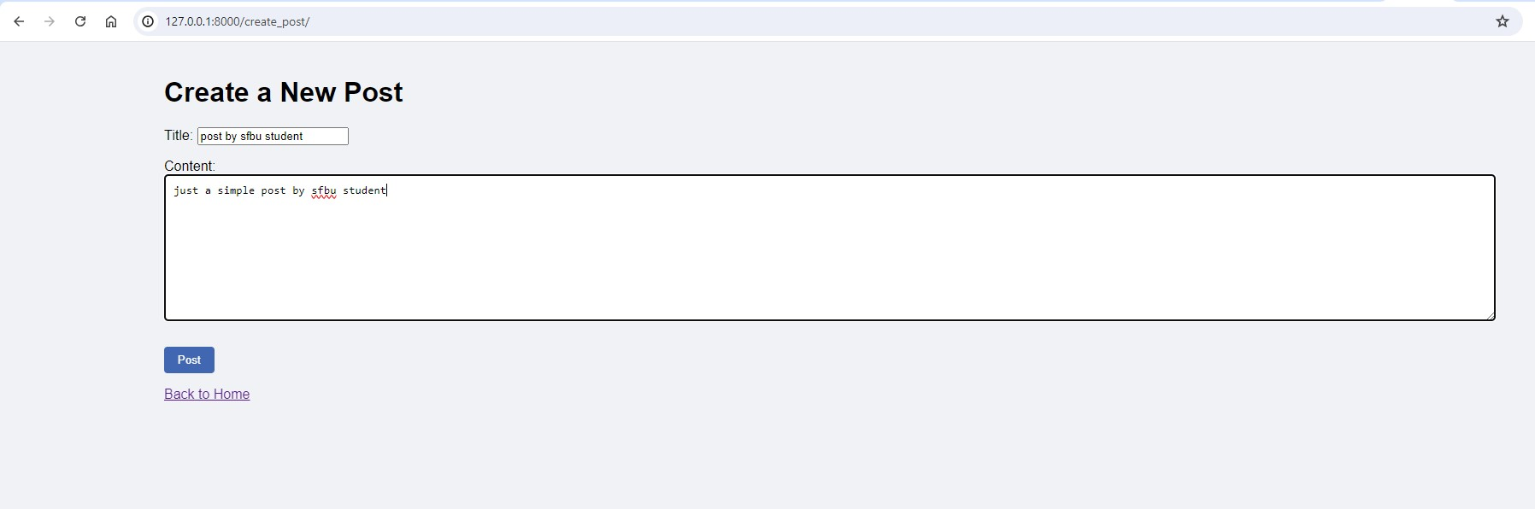
Sfbu student user 1 creating a new post

Slide 7
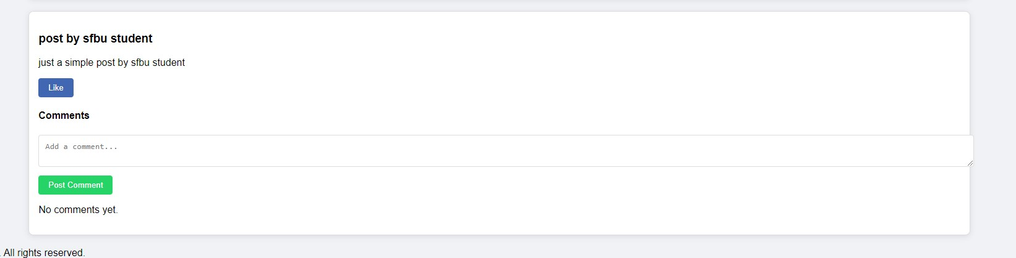
Sfbu student user 2 gets to see the post of user form the same school

Slide 8
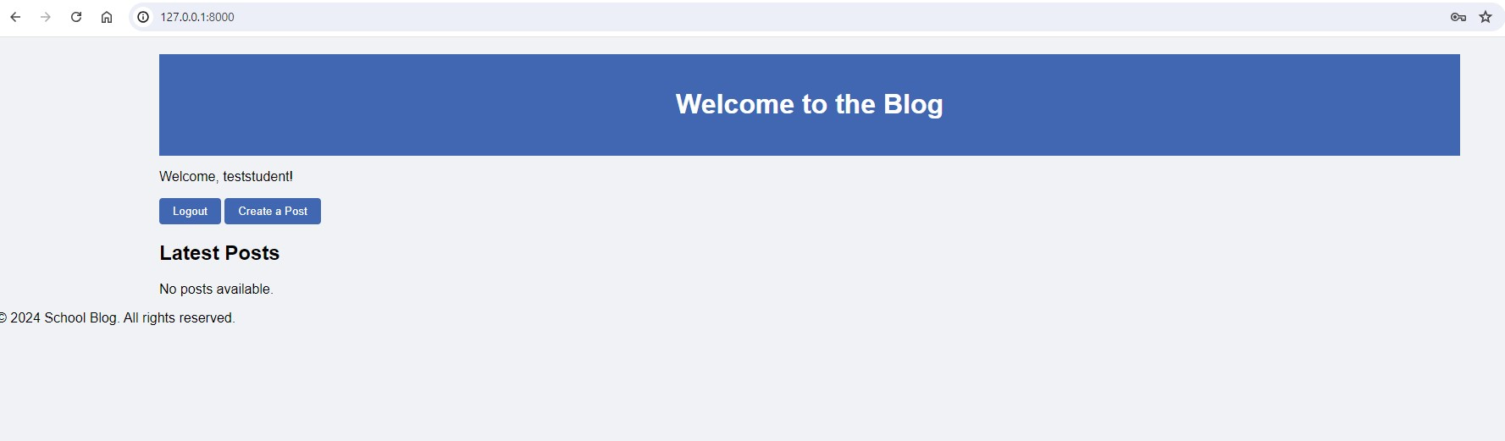
User registered with different school email do not get to see the posts of the users from the different schools.

Slide 9
Conclusion
Key features:
Successfully created a community-focused blog for school users.
Ensured secure access with domain-based registration.
Fostered user interaction through posts, likes, and comments.
Future Scope:
Implement user notifications.
Expand to support multimedia posts (images/videos).
Integrate advanced analytics for user engagement insights.

Slide 10
THANK YOU!

